Slide 1


NEWTON SCHOOL OF TECHNOLOGY
The Bargaining
Problem
A Deep Dive Into John Nash's 1950 Foundation of Game Theory
→ Narendra Singh — 2401010292
→ Ranajeet Roy — 2401010372
→ Abhijeet Kumar — 2401010015
May 2026

Slide 2


Why Should You Care?
DRAKE MEME (NASH EDITION)
Every trade deal. Every salary negotiation. Every tariff standoff. Every international treaty.
NO
Adding utilities
u₁ + u₂ = 100 (could be 100+0 or 1+99)
→All of these are bargaining problems.
→In 1950, Nash gave them all a single, provably unique answer.
→The paper is only 7 pages. The idea changed economics forever.
YES
"Every trade, every salary talk, every tariff deal is a bargaining problem. Nash gave it a single answer."
Multiplying utilities (Nash)
u₁ × u₂ = 2500 only when u₁ = u₂ = 50

Slide 3


Meet John Nash
21
Princeton grad student when he wrote this paper. Just a 21-year-old reshaping economics.
1994
Nobel Memorial Prize in Economic Sciences, jointly awarded for his work on game theory.
John F. Nash Jr.
7 pg
The entire paper is just 7 pages. Subject of "A Beautiful Mind" (2001). One of the most cited papers in economics.
1928 — 2015

Slide 4

The Bargaining Problem
Two rational individuals can collaborate for mutual benefit. Neither can harm the other unilaterally. The question: what bargain will they agree to?
PLAYERS
WHAT'S AT STAKE
→
Two rational individuals with clearly defined preferences
→
A feasible set of possible agreements, each giving both players some payoff
→
Each wants to maximize their own utility (happiness)
→
A disagreement point: what each gets if no deal is reached
→
They cannot force an outcome on the other
→
A surplus to divide: the gain from cooperating vs. walking away
P₁
P₂
If both agree, they share the surplus. If either walks away, both get the disagreement outcome.
Player One
Player Two

Slide 5

The Four Idealizations
→
Highly Rational
01
→
Perfect Self-Knowledge
02
Both players make decisions that maximize their own utility. No impulse, no emotion, no spite.
Each player knows their own preferences perfectly. No self-doubt, no shifting goalposts.
→
Equal Bargaining Skill
03
→
Full Information
04
Neither player is a better negotiator. Both use strategy with equal sophistication.
Both players know each other's preferences and available options. No hidden cards.
These are normative simplifications, not descriptive claims. The model tells us what rational agents should do.

Slide 6


Utility Theory (von Neumann-Morgenstern)
Utility = a numerical measure of how much a player prefers an outcome.
EXPECTED UTILITY FORMULA (VN-M)
u(pA + (1-p)B) = p·u(A) + (1-p)·u(B)
→ Scale Invariance
→ Why It Matters Here
Utilities are unique only up to an affine transformation: au + b, where a > 0.
Because utilities are rescalable, any fair bargaining rule must be invariant to how we set the scale for each player.
In plain English: the zero and the scale don't matter. What matters is the ratio of gains.
This is Nash's third axiom, and it's not obvious at all.

Slide 7
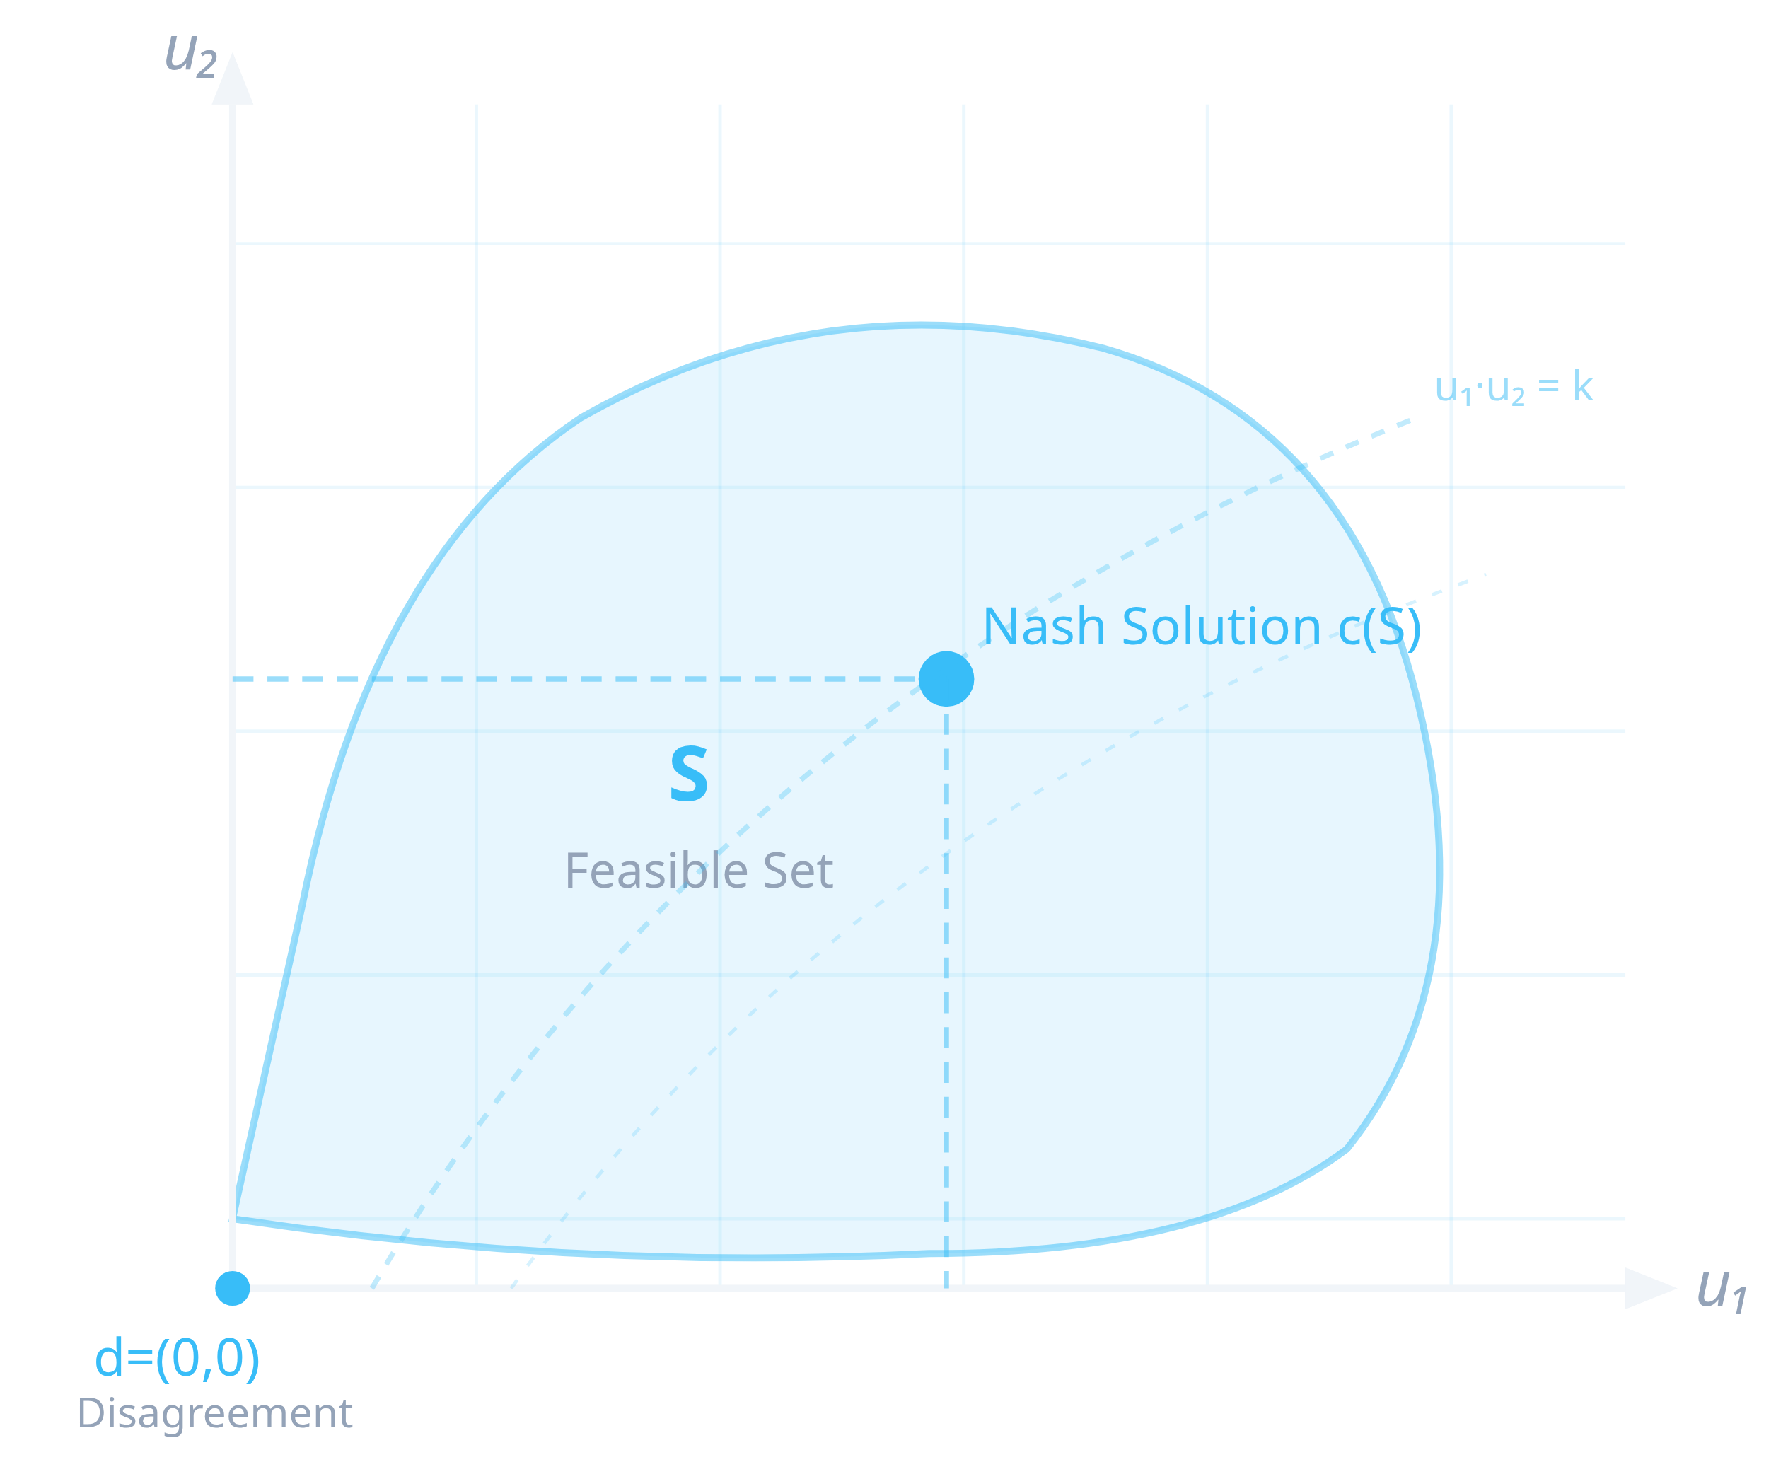

The Geometric Setup
→
S is the feasible set: all utility pairs achievable by some agreement
→
(0, 0) is the disagreement point: what each player gets if talks fail
→
S must be convex and compact (closed + bounded)
→
The dashed curves are iso-product lines: all points where u₁ × u₂ = constant
Every dot inside S is one possible bargain. Nash tells us which dot is the uniquely fair one.

Slide 8

The Four Axioms of Fairness
→
Pareto Optimality
→
Symmetry
Don't leave surplus on the table. The agreed outcome must be such that no one can do better without making the other worse off.
If both players are identical (same feasible set, same disagreement point), then fairness demands an equal split. No favoritism.
No wasted gains.
Equal players, equal payoff.
→
Independence of Irrelevant Alternatives
→
Affine Invariance
If the solution is inside a smaller feasible set, shrinking the set does not change the solution (as long as the solution remains feasible).
Rescaling a player's utility (au + b, a > 0) does not change which outcome is selected. The solution is scale-free.
Invariant to utility rescaling.
Removing bad options changes nothing.

Slide 9

NASH'S THEOREM (1950)
The Unique Fair Bargain
NASH BARGAINING SOLUTION
c(S) = arg max u₁ × u₂
subject to (u₁, u₂) ∈ S, u₁ ≥ 0, u₂ ≥ 0
Multiply the two players' gains above their disagreement points. Pick the deal with the biggest product. That is the unique fair bargain.
Four axioms. One solution. Uniquely determined.

Slide 10



Why Multiply, Not Add?
DRAKE MEME (UTILITY EDITION)
If u₁ = 100, u₂ = 0: product is 0
u₁ + u₂ = 100
NO
If u₁ = 50, u₂ = 50: product is 2500
Could be 100 + 0 = 100. Or 1 + 99 = 100. Addition cannot tell the difference.
"Multiplication punishes inequality; addition does not."
→
The Nash product is zero when any player gets nothing above their disagreement point. This forces genuine sharing.
u₁ × u₂ = 2500
YES
→
This is why Nash chose the geometric mean, not the arithmetic mean.
Maximized only when u₁ = u₂ = 50. Multiplication rewards equality.

Slide 11



A Quick Worked Example
Two friends, Aarav and Meera, share 10 chocolates. Each keeps what the other gives up. What is the fair split?
AARAV (U₁)
MEERA (U₂)
NASH PRODUCT (U₁ × U₂)
10
0
0
7
3
21
5
5
25
NASH SOLUTION
3
7
21
0
10
0
The 5-5 split is the unique Nash solution. Any deviation reduces the product for at least one player.

Slide 12


Real-World Application: India–USA Trade (2025-26)
Trump-era tariffs on Indian exports (up to 26%), India's retaliatory measures, and ongoing Bilateral Trade Agreement (BTA) negotiations — framed through Nash's model.
Player 1: USA
Player 2: India
→
Disagreement: Unilateral tariffs on Indian goods, reduced trade surplus access
→
Disagreement: Pivot to BRICS, EU partners, diversify export destinations
→
Gain from deal: Access to $1.4T Indian consumer market, pharma, IT partnerships
→
Gain from deal: Preferential US market access for $80B+ in annual exports
FEASIBLE SET
NASH SOLUTION
All possible tariff reductions, quota adjustments, and sectoral concession combinations across pharma, IT, agriculture, and manufacturing.
The tariff/quota mix that maximizes the product of both countries' net gains above their walk-away alternatives.

Slide 13



India–USA: Where the Bargain Is Breaking Down
TWO BUTTONS MEME (INDIA EDITION)
→ Violates: Full Information
Both sides hold back private information about their true red lines, creating information asymmetry.
IND
→ Violates: Symmetry Axiom
The US GDP is 8x India's. Bargaining power is deeply asymmetric. Nash's equal-skill assumption does not hold.
Sign the tariff deal (lose some farm protection)
Protect domestic farmers (risk losing US market)
→ Violates: Rationality
Domestic political pressure on farm protections and electoral considerations override pure utility maximization.
*visible sweating*
"Real bargains deviate from Nash precisely where his idealizations break."

Slide 14
Extensions Beyond Nash
Nash's solution assumes equal power. The real world often requires richer models.
→ Nash (Asymmetric)
u₁^α × u₂^(1-α)
When players have unequal bargaining power, we assign weights. Player 1 gets exponent α, Player 2 gets (1-α). When α = 0.5, we recover the original Nash solution.
Rubinstein (1950+)
→ Rubinstein Model
Provides a non-cooperative micro-foundation for Nash's axiomatic solution. Players take turns making offers with a time discount — as the time between offers shrinks to zero, the equilibrium converges exactly to the Nash solution. The cooperative and non-cooperative approaches agree.
1982
→ Kalai-Smorodinsky
Drops the Independence of Irrelevant Alternatives axiom and replaces it with monotonicity. The solution always gives each player a proportional share of their maximum possible gain. Better respects the full structure of the feasible set.
1975

Slide 15


Key Takeaways
01
→
Fair bargaining maximizes the product of utility gains
Not the sum, not the average. The Nash product u₁ × u₂ is the uniquely fair criterion that rewards genuine sharing.
02
→
Four simple axioms force this unique answer
Pareto optimality, symmetry, independence of irrelevant alternatives, and affine invariance together pin down exactly one solution.
03
→
Real bargains (including India-US trade) are deviations from this benchmark
Nash's model is most useful as a benchmark. Where real deals fail, one of his four axioms has been violated. Diagnose the axiom to fix the deal.

Slide 16

Thank You
Q&A
Built on Nash. Inspired by Newton School of Technology.
→ Narendra Singh — 2401010292
→ Ranajeet Roy — 2401010372
→ Abhijeet Kumar — 2401010015
NEWTON SCHOOL OF TECHNOLOGY — MAY 2026

